Slide 1

MTECH PROJECT
MASTERCARD PERSONAL EXPENSE MANAGEMENT SYSTEM – (MPEMS)
PHASE 1 PRESENTATION - TEAM S2

Slide 2

Presentation Overview
Session | Description | Approx. Duration
Presentation | Project Background & Team Introduction | 2 minutes
 | User Requirements Overview | 5 minutes
 | Project Risks | 6 minutes
 | Technical Challenges | 2 minutes
 | Overall Project Strategies (Management & Technical) | 3 minutes
 | Project Timeline and Estimates | 8 minutes
 | Project Current Progress | 2 minutes
 | Management Problems | 2 minutes
Q & A | Question and Answer | 15 minutes
Total |  | 45 minutes

Slide 3
Project Background
&
Team Introduction

Slide 4
Project Background
Project Customer
  MasterCard Singapore
Citibank
CreditCard
MERCHANT
( NIKE SHOP)
MERCHANT’S BANK
( OCBC)
MASTER
CARD
ISSUER
BANK
( CITIBANK )
System Objective
  Provide Personal Expense Management System for customers to easily track and manage their spending
Motivation
  Absence of consolidated view of all transactions
  Spenders getting more sophisticated
  Lack of CRM from existing payment service
  Growing number of tech savvy credit/debit card users
  An opportunity to enhance customers experience with MasterCard

Slide 5
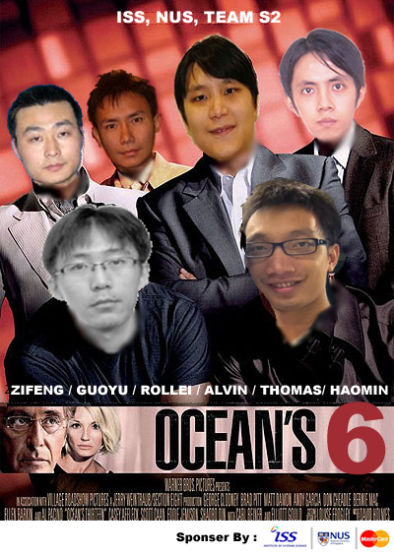
Project Team
ROLLEI
(Project Manager)
HAO MIN
(Implementation Manager)
ALVIN
(Quality Manager)
ZI FENG
(Test Manager)
THOMAS
(Business Analyst)
GUO YU
(Solution Architect)

Slide 6
Requirements Overview

Slide 7
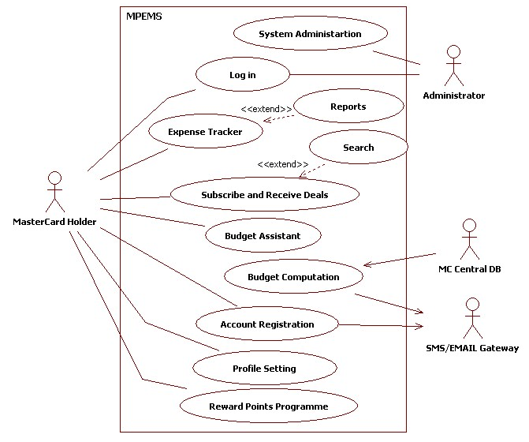
Requirements Overview

Slide 8
Use Case – Expense Tracker
Summary view of total spending. By card, by category, by period
Search, retrieve and display all individual MasterCard transactions from all banks
Assign transaction to a specific category type
Add more details to a transaction
View spending patterns in the form of reports e.g. line chart, bar chart etc
Download transaction data (in CSV format) for filing or offline view.

Slide 9
Requirements Overview

Slide 10
Use Case – Budget Assistant & Computation
Set spending budget for individual card OR overall budget for all cards – by period (e.g. weekly, monthly)
Set spending budget for individual card OR overall budget for all cards – by period (e.g. weekly, monthly)
Receive SMS/Email notification when pre-defined budget exceeded

Slide 11
Requirements Overview

Slide 12
Use Case – Deals and Reward Programmes
Subscribe, unsubscribe to the list of deals category
Search deals in MasterCard deals database
View Deal details and access to deal’s website
View reward points earned
Redeem vouchers using reward points

Slide 13
Requirements Overview

Slide 14
Use Case – Account Registration and Profile Setting
Register an account and receive Email/SMS notification.
Reset Account Password
Add/Remove Credit Card from account
Change account password
Change account details (e.g. address, name etc)

Slide 15
Requirements Overview

Slide 16
Use Case – System Administration
Member Management Reset Account Password
  Search, View and Deactivate/Activate Account
Voucher Management
  Search, View and Update
Deals Management
  Search, CRUD
Merchant Management
  Search, CRUD

Slide 17
Project Risks

Slide 18
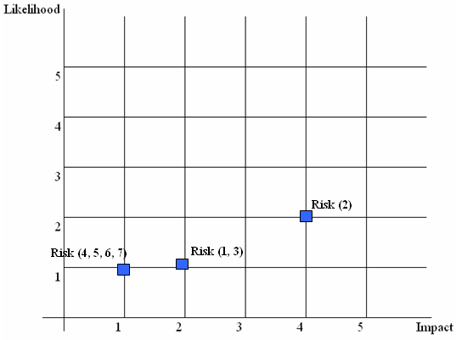
Project Risk
# | Risk
1 | Team member departure and unavailability
2 | Project client commitment to the project and availability
3 | Insufficient hardware server to act as central database and application environment
4 | System portability risk
5 | Dependency on third-party library and lack of experience in third-party library
6 | Lack of experience in Responsive UI design for Mobile Website
7 | Uncertain and Changing requirements

Slide 19
Risk Technique - 1
# | Risk | Control Type | Techniques
1 | Team member departure and unavailability | Risk Transfer | Every project member will undertake a primary and secondary role. E.g. Team Member Alvin will have a primary role as a Quality Manager and Secondary role as a Project Manager. Alvin will have to take on the PM responsibility should the current PM leaves the team or took long offs from the project
 |  | Risk Avoidance | The man day estimated for each member should not exceed 70 days. This will help to ensure that the members will not be severely overloaded should there be a case where they need to take on leaving member’s teak.
 |  | Risk Minimization | Anticipate all oversea leaves, marriage plan, baby plan, relocation plan etc and factor these to schedule and effort planning
2 | Project client commitment to the project and availability | Risk Minimization | Continuously keep the project client updated with the project progress and future plans. Understand that the requirements will change over a long period and be open minded and flexible to these changes while ensuring that the change will not significantly affect the project schedule and effort
 |  | Risk Transfer | Request for a covering officer from project client. Keep the covering officer updated with the project progress and plans.
3 | Insufficient hardware server to act as central database and application environment | Risk Transfer | The server environment will be replicated and back up on a solution architect personal notebook. If the main server fail to work. Solution architect personal notebook will be activated immediately to avoid any delay due to the unavailability of server environment.

Slide 20
Risk Technique - 2
# | Risk | Control Type | Techniques
4 | System portability risk | Risk Minimization | Use known widely tested javascript package such as prototype, jquery
 |  | Risk Insurance | Shortlist 2 most widely used desktop browser and mobile browser. Design and test the system on the selected browsers. Inform project client that this is a limitation faced by all web application. Although it may not run on all browsers, it should run on the major browsers
5 | Dependency on third-party library and lack of experience in third-party library | Risk Minimization | Factored in the effort required by the solution architect to study third-party library.
 |  | Risk Minimization | Build and test the prototype using the third-party library.
6 | Lack of experience in Responsive UI design for Mobile Website | Risk Minimization | Factored in the effort required by the business analyst to study mobile website UI design.
 |  | Risk Minimization | Business analyst to create a UI specification. Build a prototype to test the UI usability. Analyze user’s feedback on prototype and incorporate the change when required.
7 | Uncertainty and Changing requirements | Risk Minimization | Build and walk through use case document and prototypes with client to ensure all essential functions have been accurately captured in functional specifications
 |  | Risk Minimization | Emplace proper change procedures to control changing requirements

Slide 21
Technical
Challenges

Slide 22
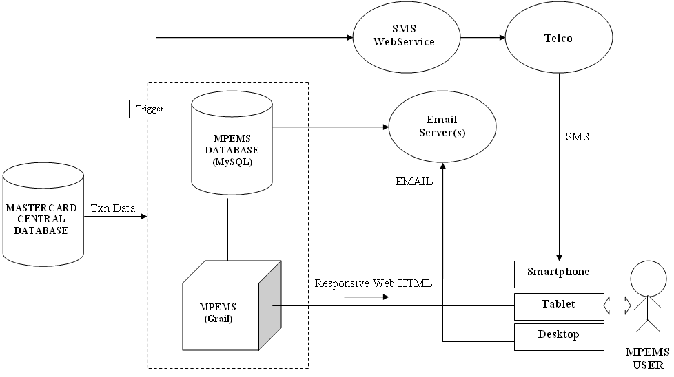
Technical Challenges
MPEMS High-level Architecture

Slide 23
Technical Challenges
trigger call to SMS gateway when transaction records are refreshed
Possible solutions
  SQL Triggers
  OS Services/ Background Agent
  Scheduled Job
  API

Slide 24
Technical Challenges
Responsive Web Design
  The Responsive Web Design is the practice to use fluid layouts and media queries to create designs able to adapt according to the user’s screen resolution.
  It allows to eliminate the need to create different designs (read templates) for each device (that in these days means desktop, netbook, tablet and mobile).
  Extracted from http://www.maurizioconventi.com/2012/02/08/responsive-web-design-with-twitter-bootstrap/ example : http://spigotdesign.com/
Challenges
  Relatively a new approach in UI Design (not a mature design methodology)
  Team member lack experience

Slide 25
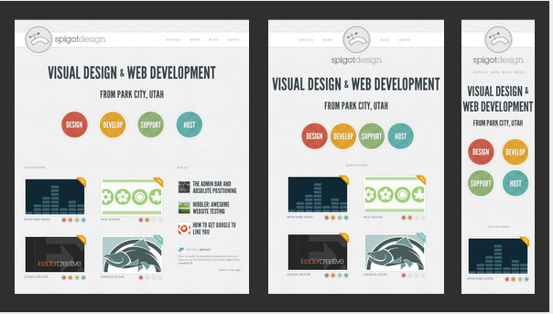
Technical Challenges
Example : e.g. http://spigotdesign.com/

Slide 26
Overall Project Strategies (Technical & Management)

Slide 27
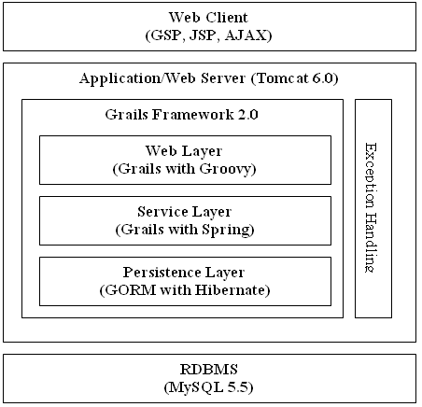
Overall Project Strategies
(Technical & Management)
Technical Strategies
  Quality Planning (e.g. user control, change control)
  Build detailed and reusable prototype in the early stage of the project
  Capitalize on known packages to expedite development progress. E.g. grails and prototype
MPEMS - Layered Application Architecture

Slide 28
Overall Project Strategies
(Technical & Management)
Management Strategies - 1
  Building a good relationship with our client (customer oriented)
  Effective Risk Management
    Prioritize risk
    Monitoring
    Contingency plan
  Team bonding
    Lunch & Dinner together
  Always aim for win-win situation

Slide 29
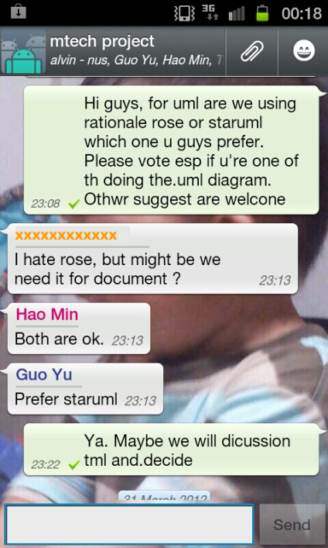
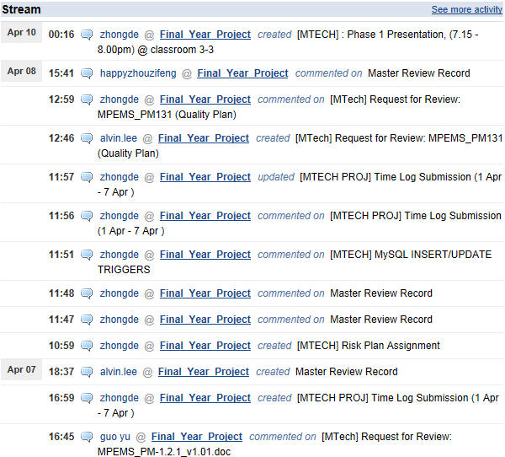
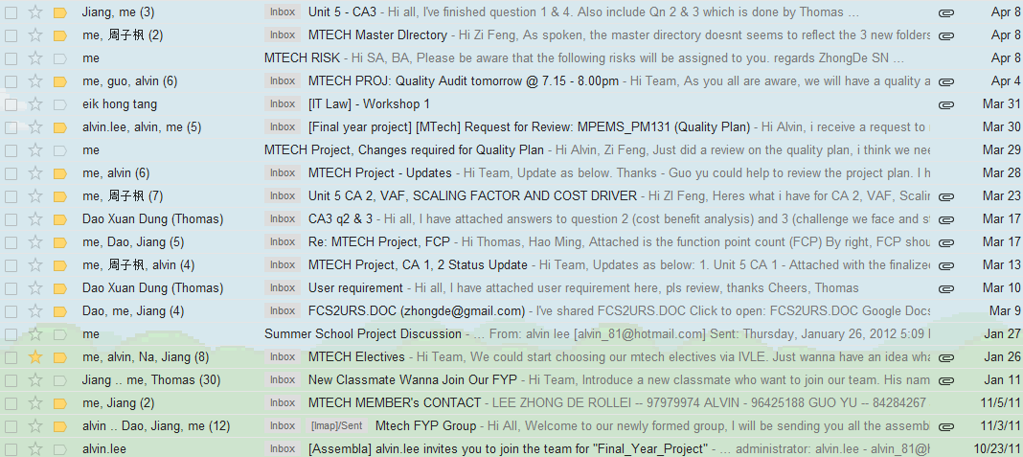
Overall Project Strategies
(Technical & Management)
Management Strategies - 2
  Practise active and effective Group Communications
Group Discussion
in Whatsapp
News Feeds from Assembla
Email exchange
in Gmail

Slide 30
Project
Effort Estimates
&
Timeline

Slide 31
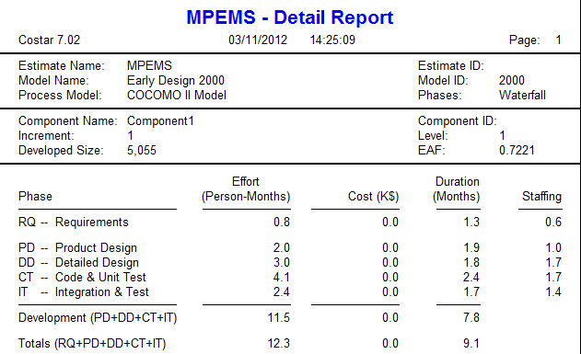
Project Effort Estimates - COCOMO
The estimated effort for the scope of this project based on COCOMO using Functional Point Count is 12.3 Person-Months which is equivalent to 374 man days.

Slide 32
Project Effort Estimates - WBS
The estimated effort for the scope of this project based on WBS and project team judgment is 369.5 Man days
Phase | # | Task Name | Estimates
Project Planning | 1 | Project Planning & Quality Planning | 24
 | 2 | Requirement Analysis | 14
 | 3 | First Quality Audit Meeting | 5
 | 4 | First Project Presentation | 4.5
Analysis and Design | 5 | Analysis Modeling | 66
 | 6 | High Level Design Modeling | 19
 | 7 | Prototype | 33.5
 | 8 | Second Quality Audit Meeting | 5
 | 9 | Second Project Presentation | 4.5
Implementation | 10 | Detailed Design Modeling | 27.5
 | 11 | Implementation | 56
 | 12 | System Testing | 37
 | 13 | User Acceptance Testing | 26.5
 | 14 | Project Closure | 27.5
 | 15 | Third Quality Audit Meeting | 5
 | 16 | Third Project Presentation | 14.5
Total Estimates |  |  | 369.5

Slide 33
Project High Level Timeline
Phase | # | Task Name | Start Date | Finish Date
Project Planning | 1 | Project Planning & Quality Planning | Fri 2/17/12 | Sun 4/1/12
 | 2 | Requirement Analysis | Sat 2/25/12 | Sun 4/1/12
 | 3 | First Quality Audit Meeting | Sat 3/31/12 | Tue 4/3/12
 | 4 | First Project Presentation | Sun 4/1/12 | Tue 4/10/12
Analysis and Design | 5 | Analysis Modeling | Wed 4/11/12 | Sat 8/11/12
 | 6 | High Level Design Modeling | Sun 5/27/12 | Sat 8/11/12
 | 7 | Prototype | Sun 7/8/12 | Sat 8/11/12
 | 8 | Second Quality Audit Meeting | Sat 8/11/12 | Tue 8/14/12
 | 9 | Second Project Presentation | Sun 8/12/12 | Tue 8/21/12
Implementation | 10 | Detailed Design Modeling | Wed 8/22/12 | Mon 9/10/12
 | 11 | Implementation | Sun 9/2/12 | Sun 9/23/12
 | 12 | System Testing | Sun 9/2/12 | Sun 10/14/12
 | 13 | User Acceptance Testing | Sun 10/14/12 | Sun 12/2/12
 | 14 | Project Closure | Mon 12/3/12 | Fri 1/4/13
 | 15 | Third Quality Audit Meeting | Sat 1/5/13 | Tue 1/8/13
 | 16 | Third Project Presentation | Wed 1/9/13 | Tue 1/15/13

Slide 34
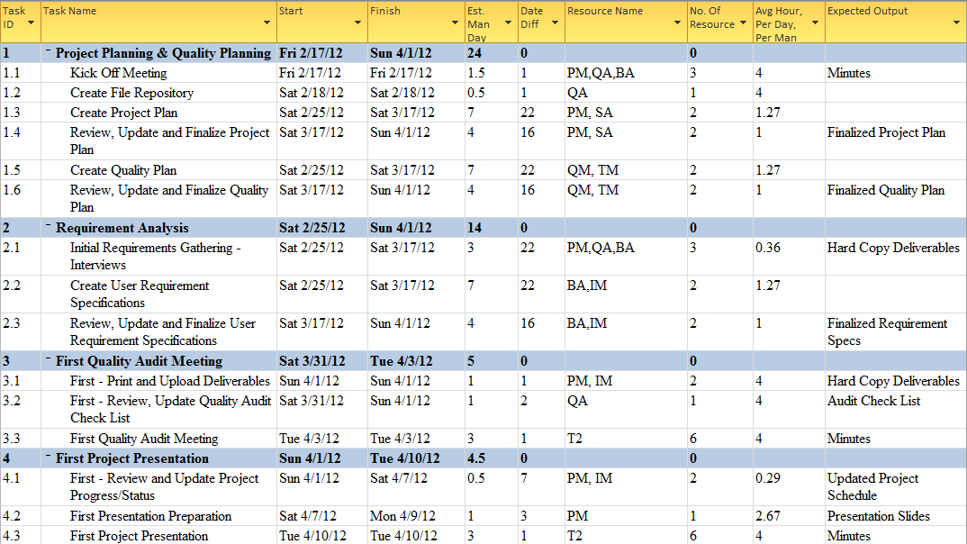
Project Timeline & Estimates ( Phase 1)

Slide 35
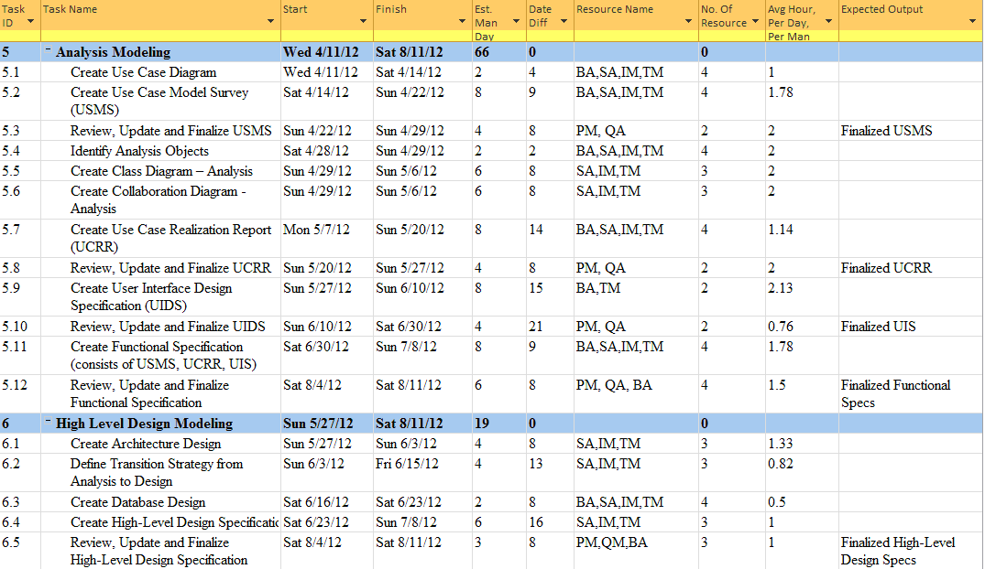
Project Timeline & Estimates ( Phase 2 , Part 1)

Slide 36
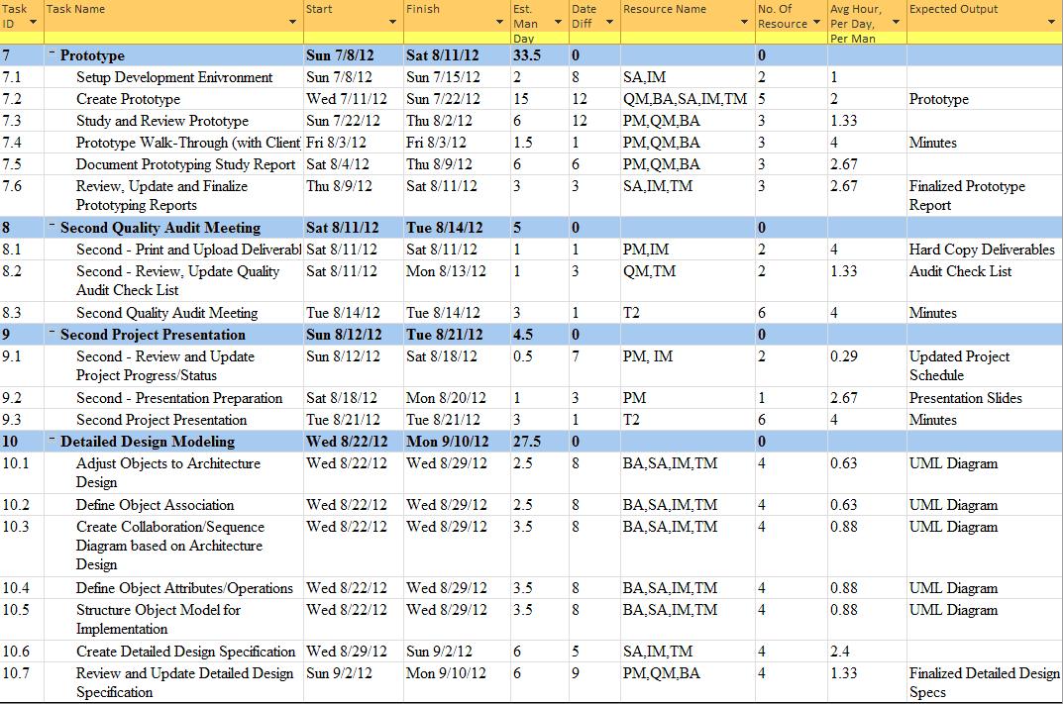
Project Timeline & Estimates ( Phase 2 , Part 2)…

Slide 37
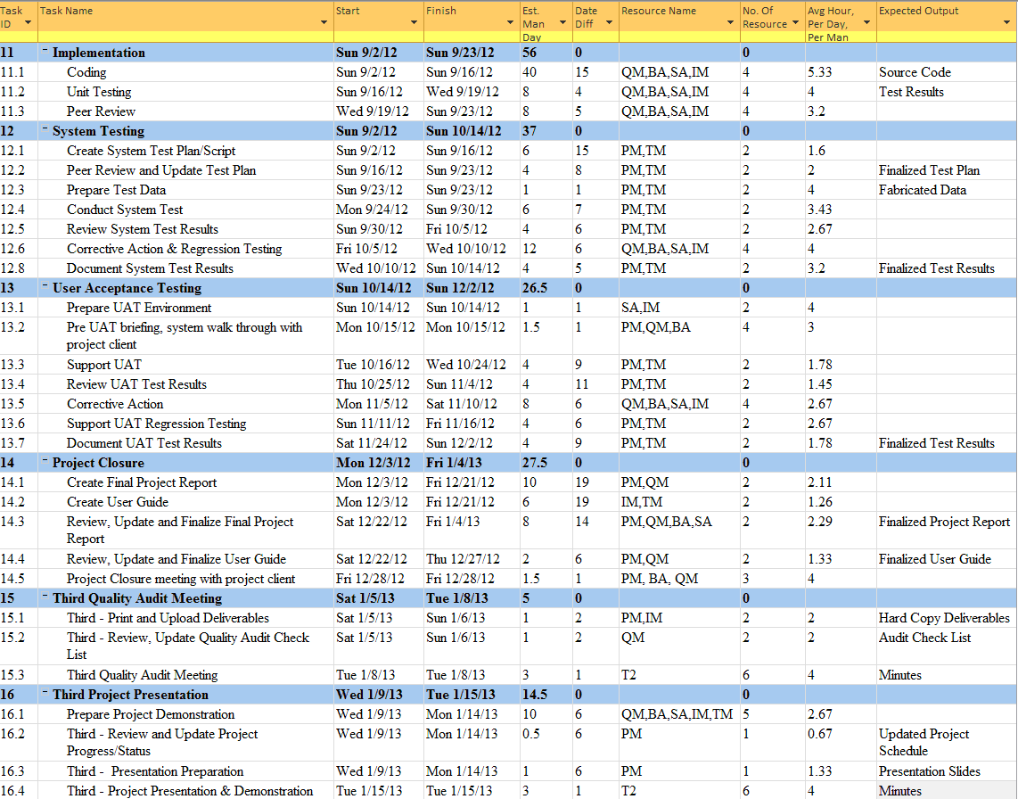
Project Timeline & Estimates ( Phase 3)

Slide 38
Project Current
Progress

Slide 39
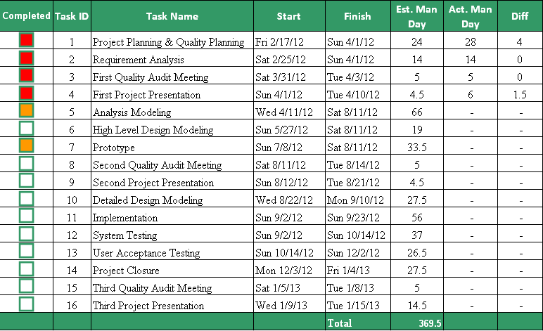
Project Progress

Slide 40
Management Challenges
Loss of Team Members
Lack of Requirements
  Constrained by client requirements
    Application portability
    Lack of useful data
Tight timeline

Slide 41

Question & Answers

Slide 42

THE END

